Slide 1

Team 01 + 07
Full System Walk Around

Slide 2

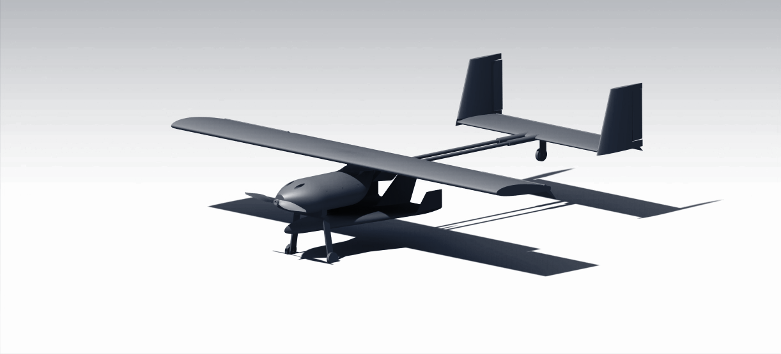
Walk around
Modular wing NACA 2412 supported with spar
NACA 0010 H-Tail
Double carbon fiber rod boom
Fuselage and electronics bay
Tail dragger landing gear
Glider placed underneath fuselage, CG aligned

Slide 3
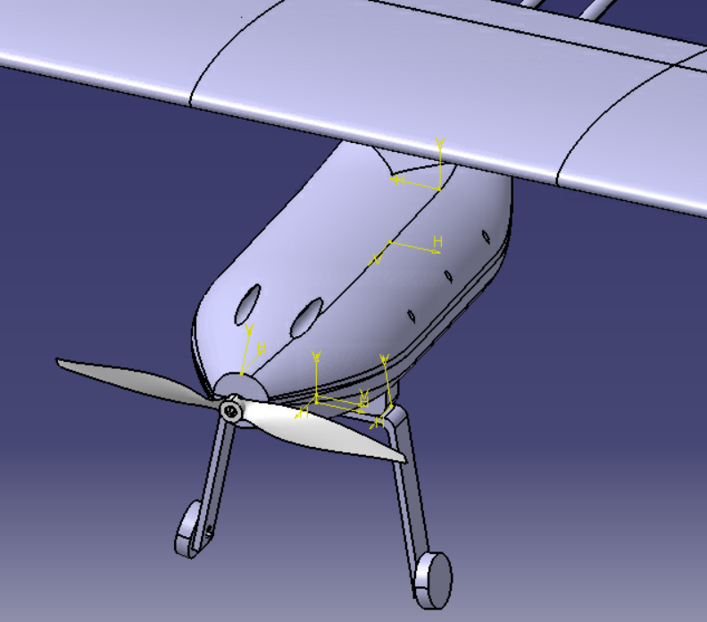
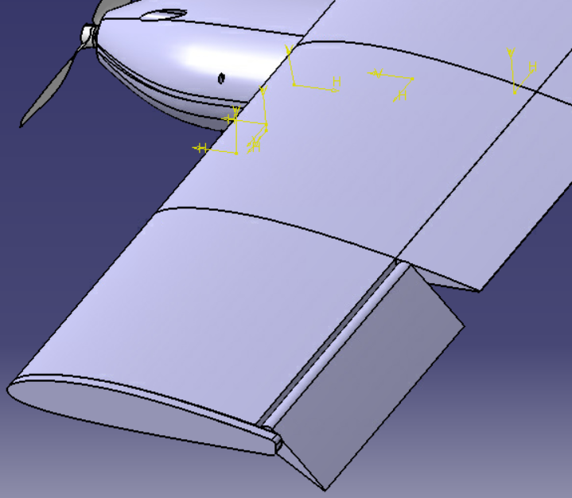
Walk around (cont.)
Easily-open fuselage contains electronics & propulsion system
Modular wings supported with spars
Custom landing gear with 1.5" Diameter Foam Wheel
APC 12x6 Propeller
Flaperon

Slide 4
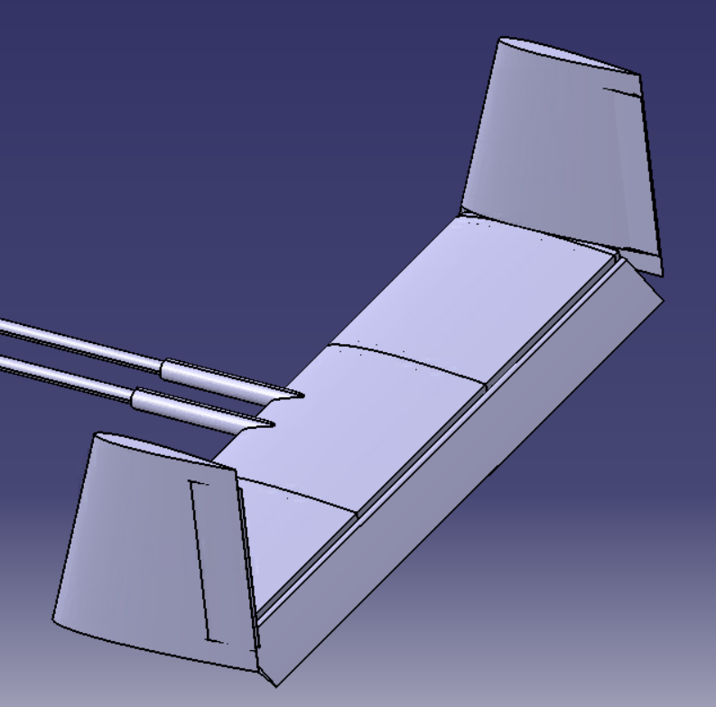
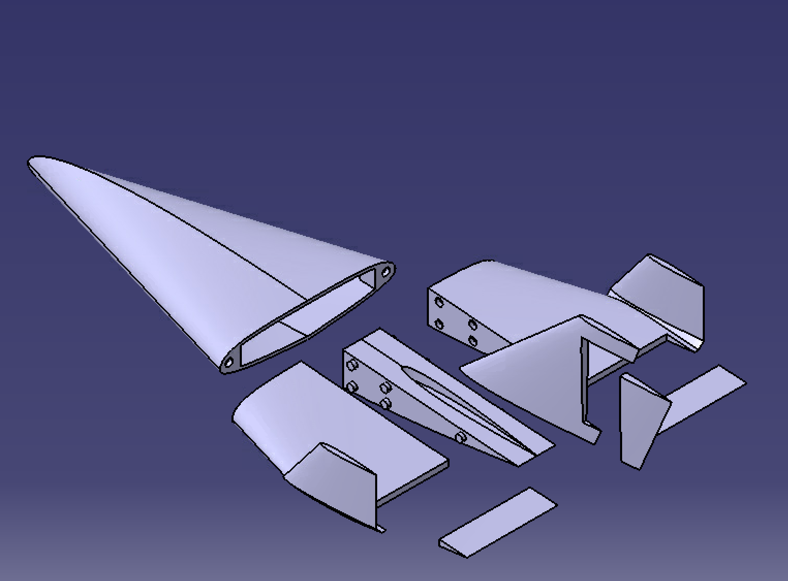
Walk around (cont.)
Payload Housing
Elevon
Winglets
H-tail with rudder and elevator controls
Rudder

Slide 5

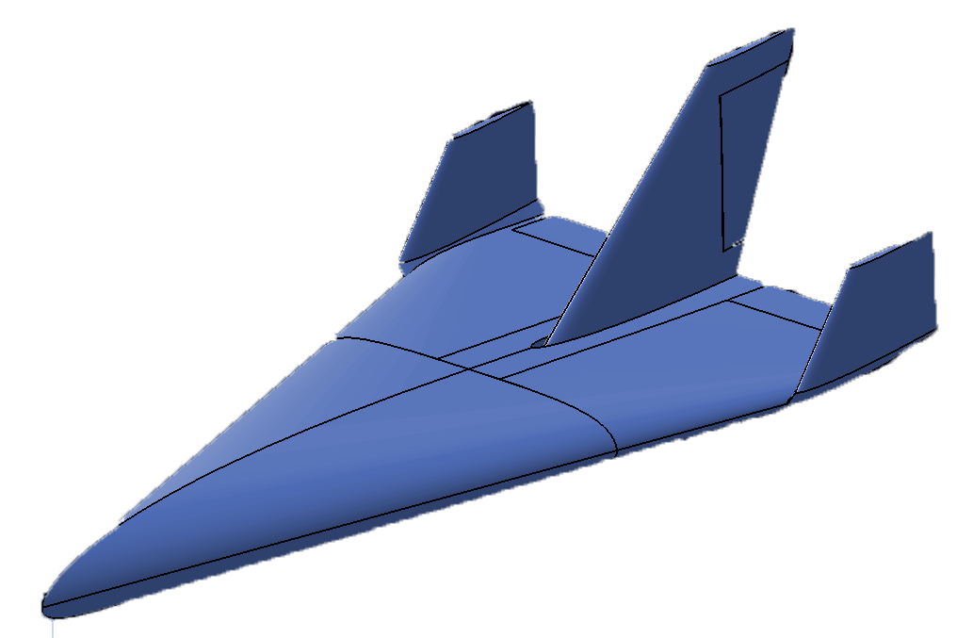

TRIDENT
Kunal Bhanushali
Austen Bowen
Griffin Holland
Christev Schade
Samuel Zhang
Notes:
Team 1: Trident Glider System

Slide 6

Outline
Milestones
Design
Aerodynamics
Stability
Structures/Weights
Production
Flight Plan
Notes:
Quick summary of what we will be going through

Slide 7
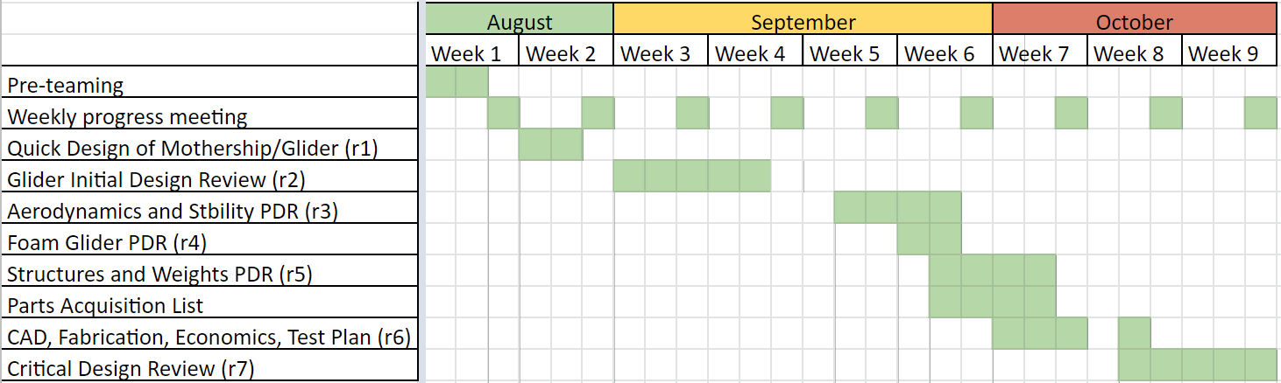
Milestones
Finalized an innovative design to meet mission objectives and constraints
Utilized simulations and a prototype to determine optimum stability
Completed first detailed CAD draft model
Proposed and began initializing a structures plan to 3D print design
Notes:
Milestones, key achievements (excellent stability and prototype flight), shortcomings (structures and weight), readjustments, (tail, airfoil and size changes) regularly meeting times, general stuff

Slide 8

Design
Notes:
Now I will leave you to Kunal to discuss our Glider’s design.

Slide 9
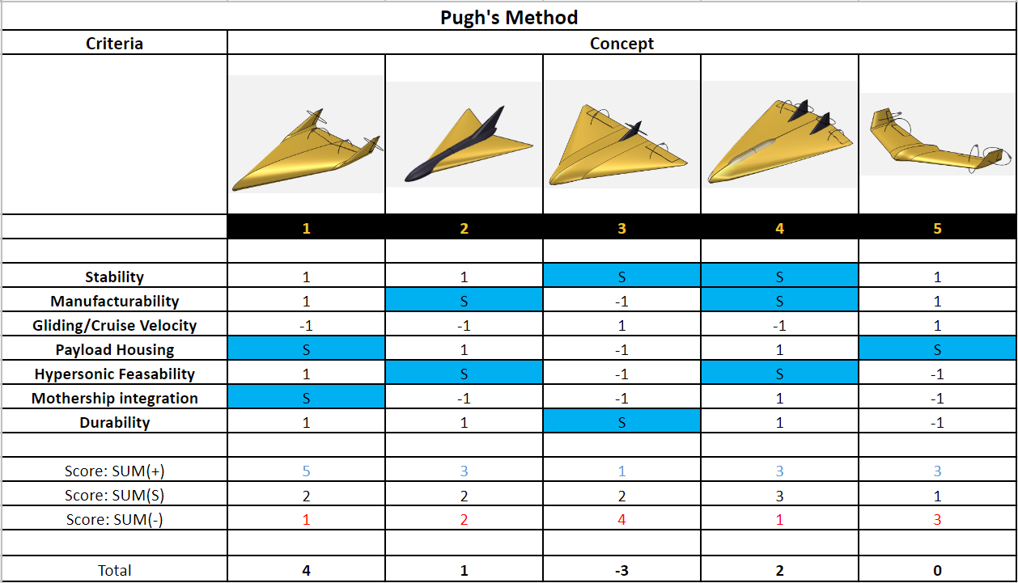

Pugh’s Matrix
Preliminary conceptual designs considered for mission

Slide 10
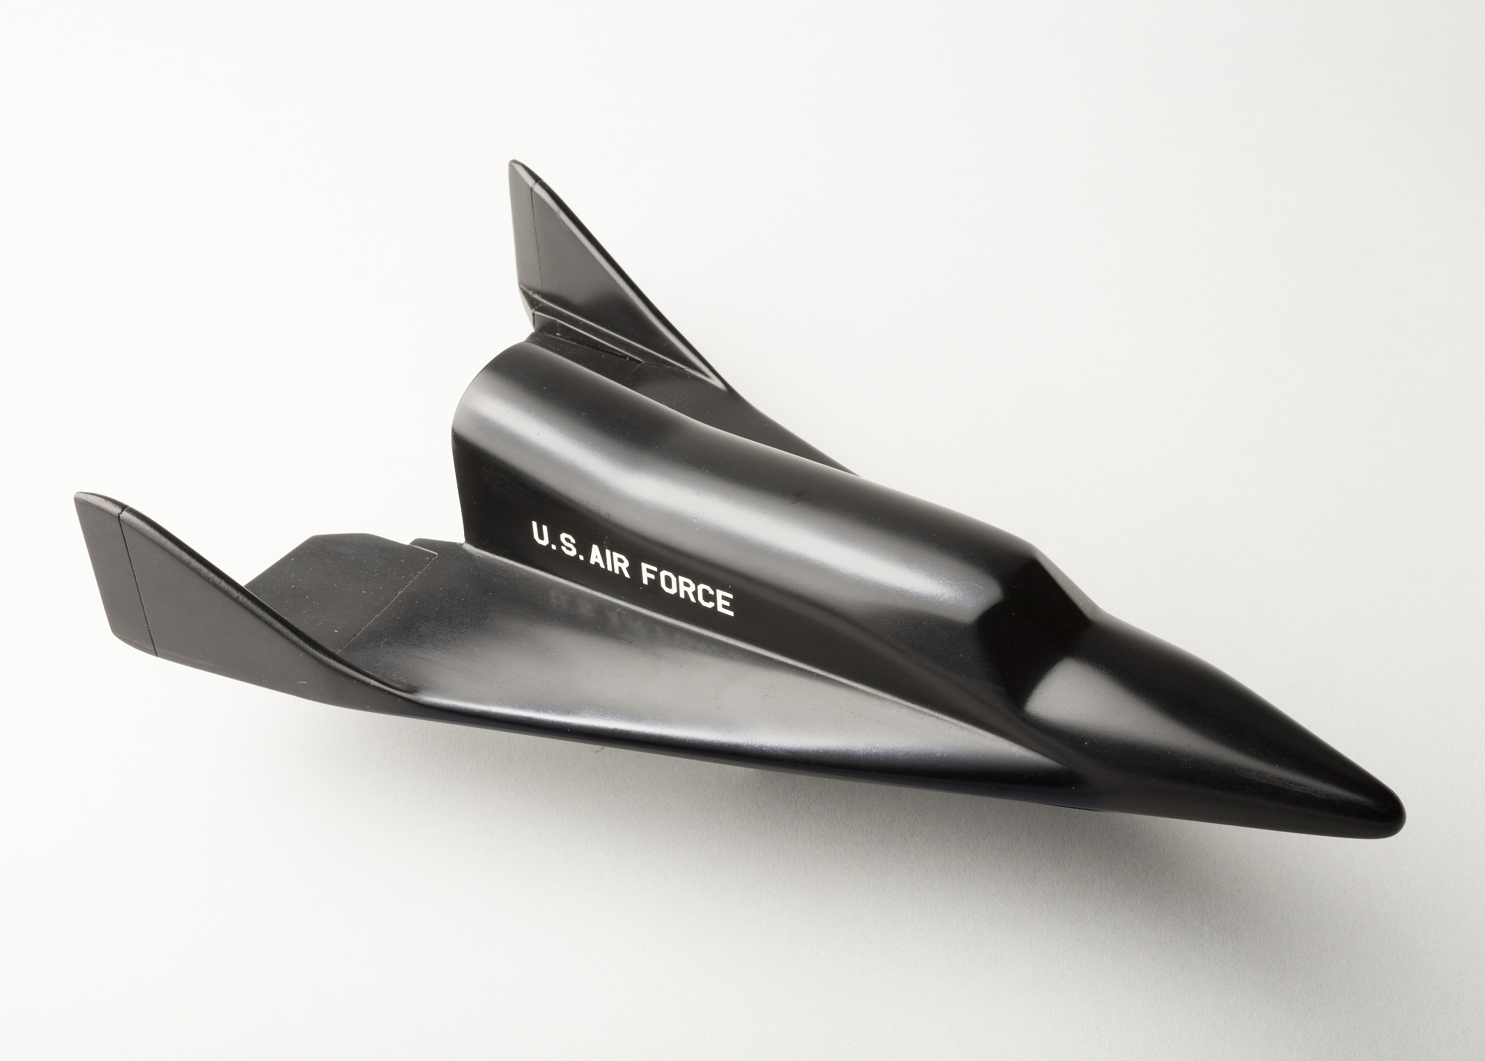
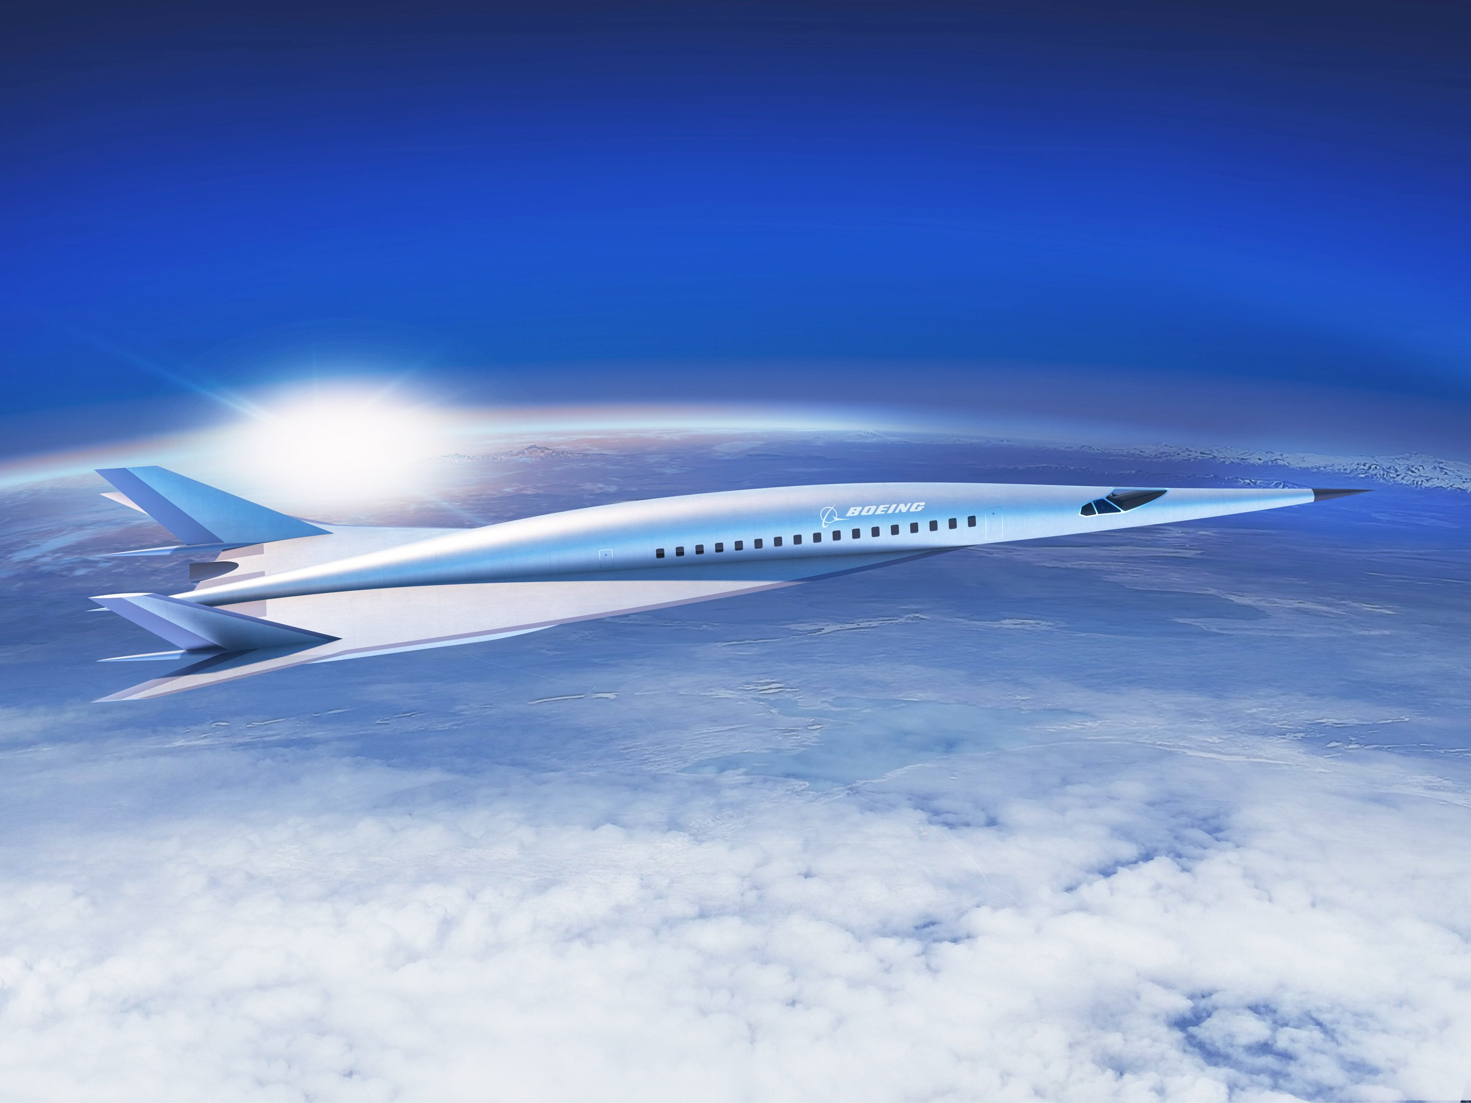

Design Inspirations
X-20 Dyna-Soar
Boeing Hypersonic Passenger Jet Concept

Slide 11
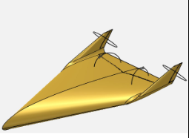
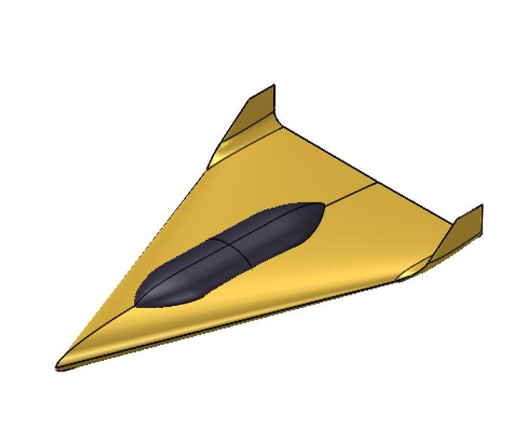
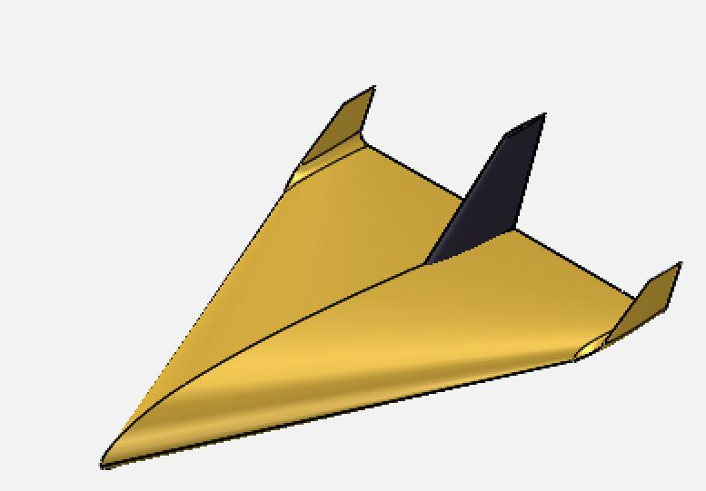
Design Progression
Pugh’s Matrix Design
x2 Fin, x1 Elevon
Post-Aerodynamic Analysis Design
NACA 2210
Center-body pod to house payload
Control Team Design
NACA 2210
x1 Fin, x2 Elevon
No center pod
Scaled smaller

Slide 12
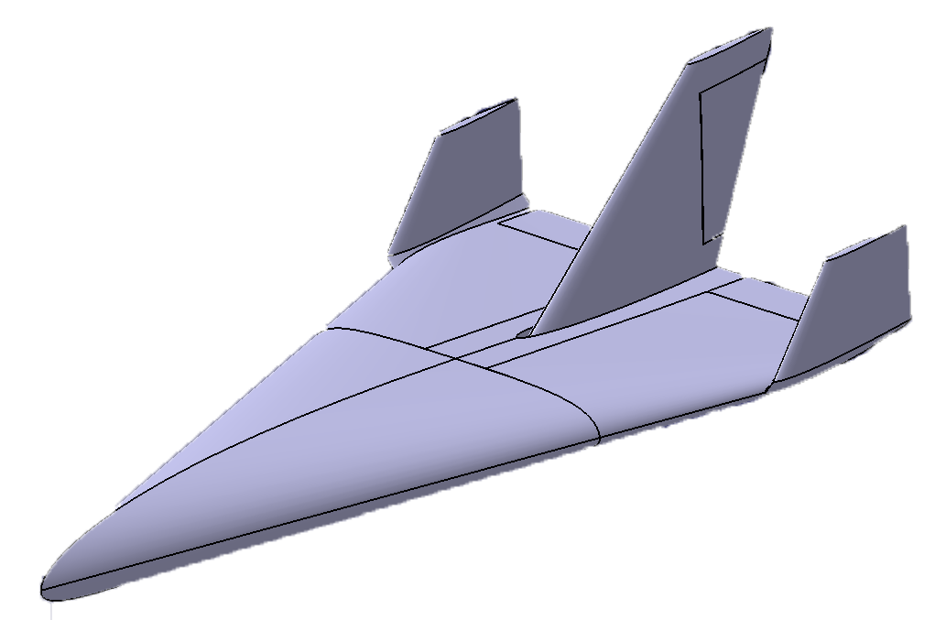

Proposed Solution
Post-Stability Analysis Design
NACA 1210 1.5% Spline
x1 Fin, x2 Elevon

Slide 13
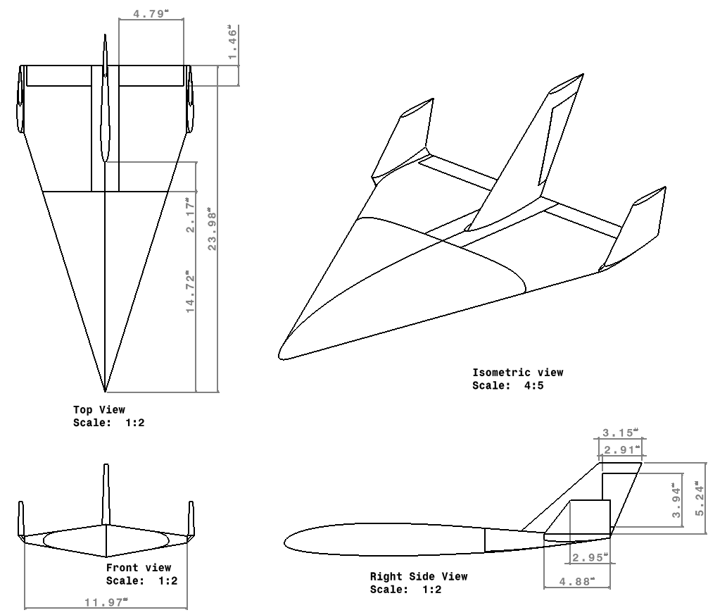
Aircraft Specifications
Wing Surface Area | 79.3701 | in²
Aspect Ratio | 1.045
Airfoil | NACA 1210 1.5% Spline

Slide 14
Aerodynamics

Slide 15
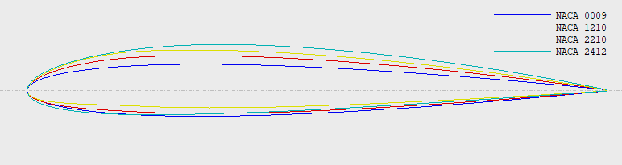
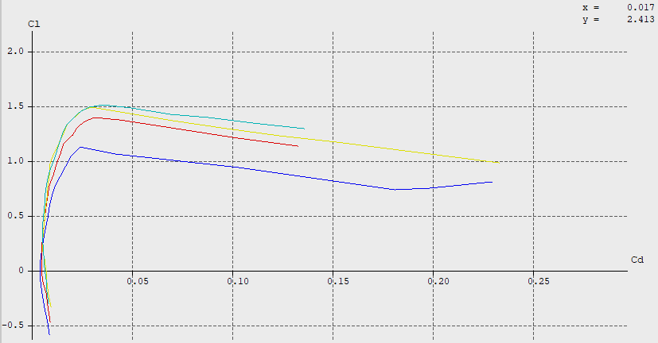
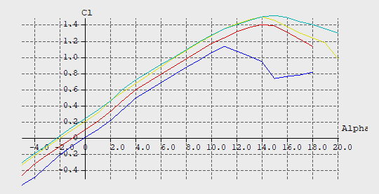

Airfoil Selection
NACA 1210

Slide 16
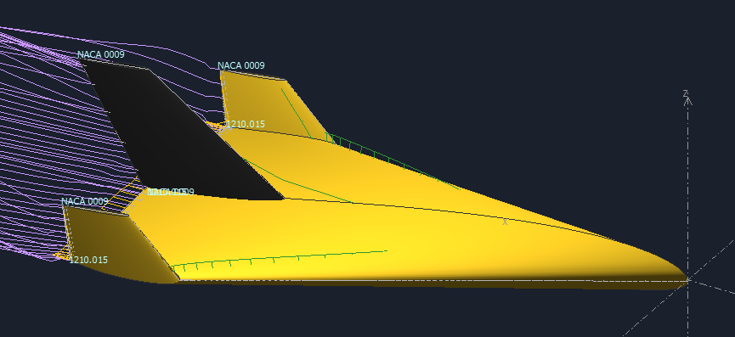
Aerodynamic Performance at Launch
𝛼 | 7.595 | degrees
L/D Ratio | 7.455
Cd | 0.017
Cl | 0.128
U∞ | 59.056 | ft/s
V_{STALL} | 37.694 | ft/s
R_{60°} | 54.504 | ft

Slide 17
Stability

Slide 18
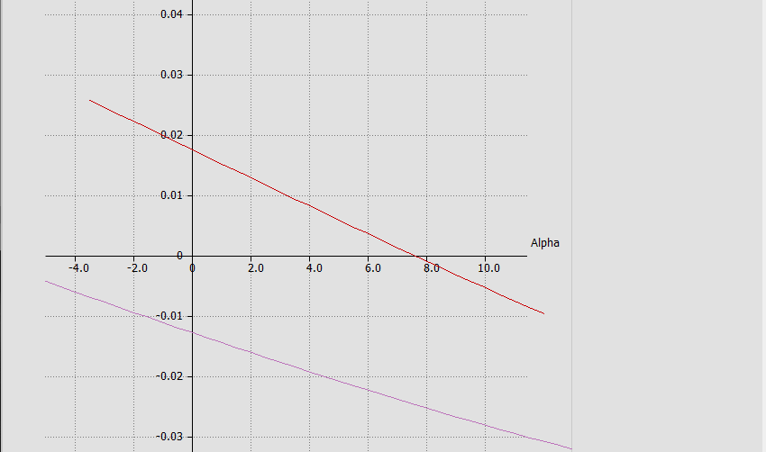
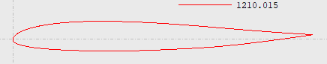
Reflex Airfoil Design
Goal: create negative slope with a positive y intercept on the C_{M} vs Alpha graph
Chose the NACA 1210 with the trailing edge spline point raised by 1.5% of the chord length

Slide 19
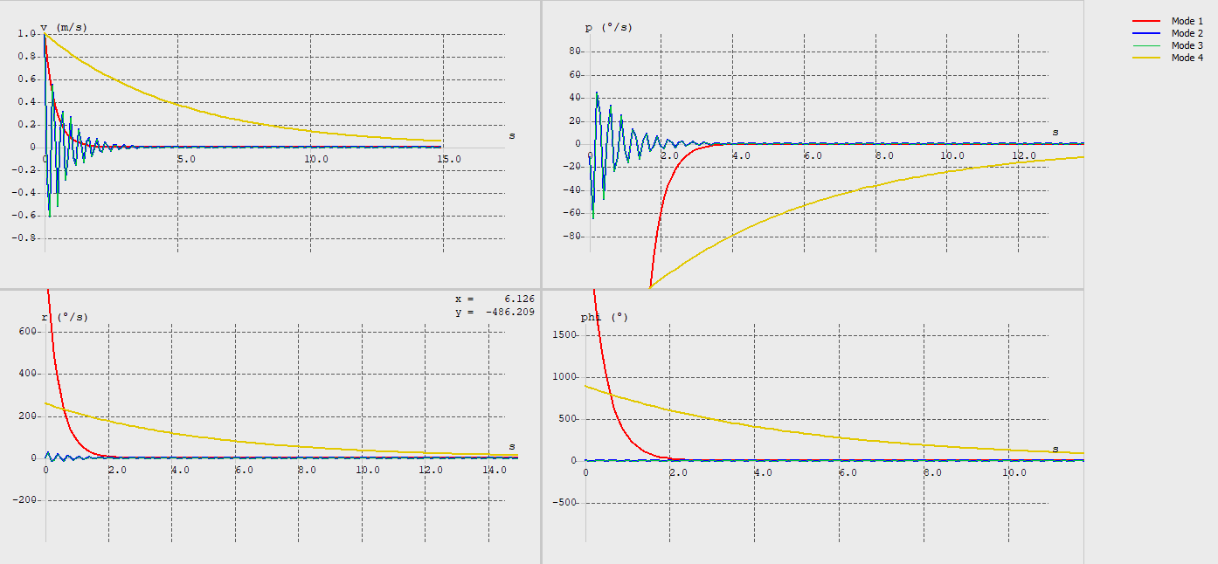
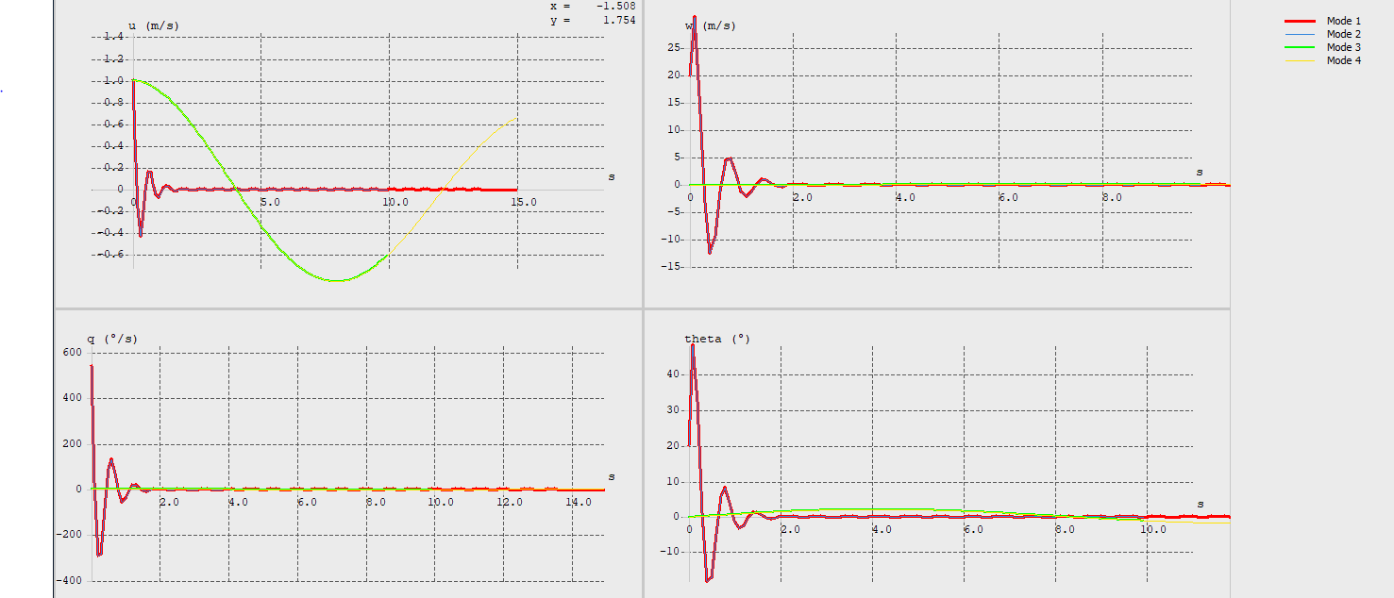
Stability Analysis
Lateral
X_{Cp} | 0.607c
X_{Cg} | 0.531c
X_{ac} | 0.617c
C_{m𝛼} | -0.104
C_{nβ} | 0.321
C_{Lβ} | -0.143
Longitudinal

Slide 20
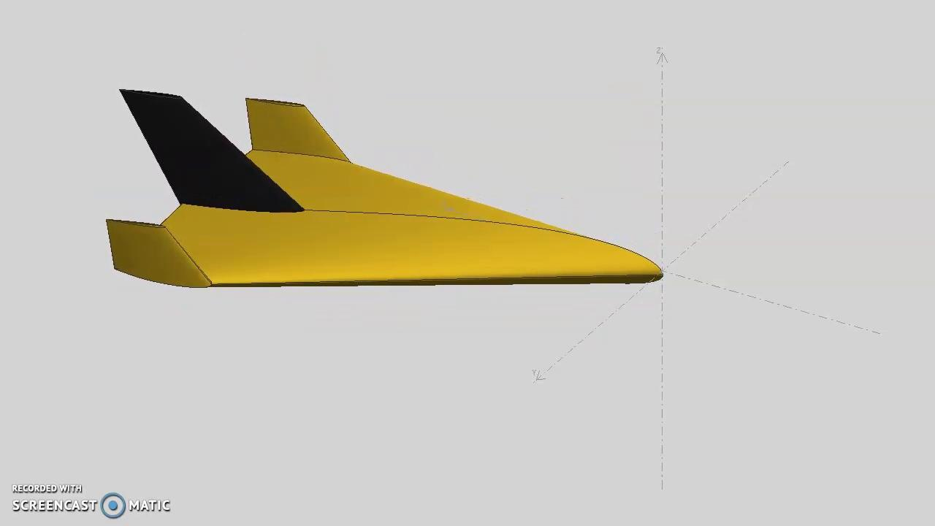
Stability Simulation

Slide 21
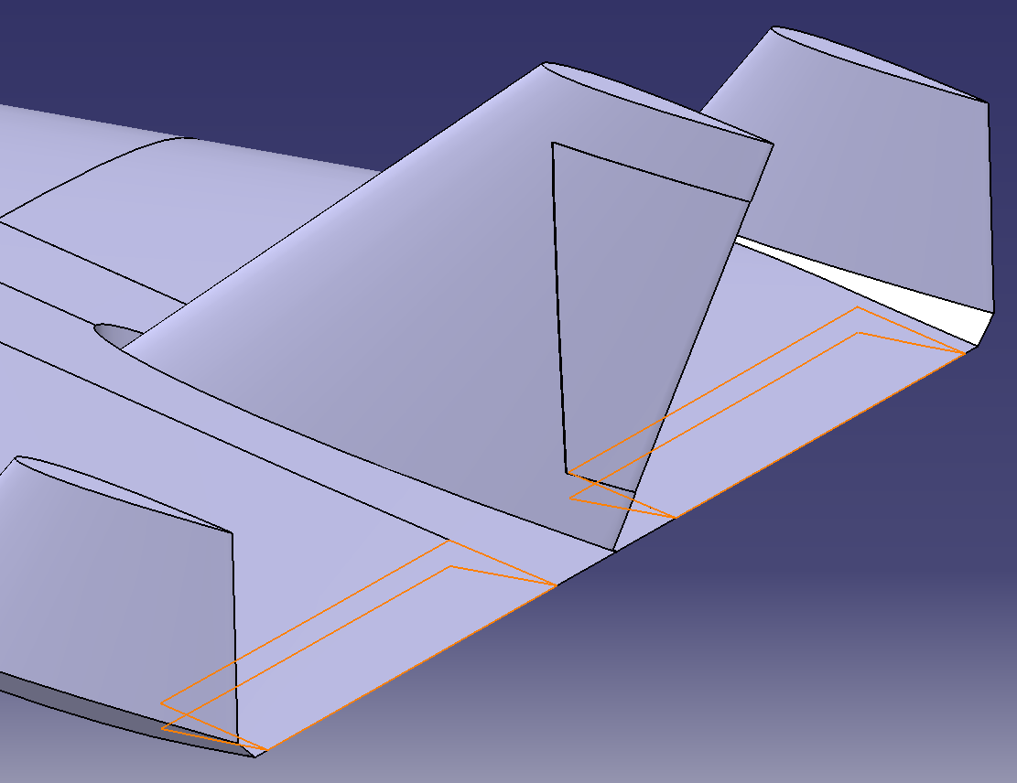
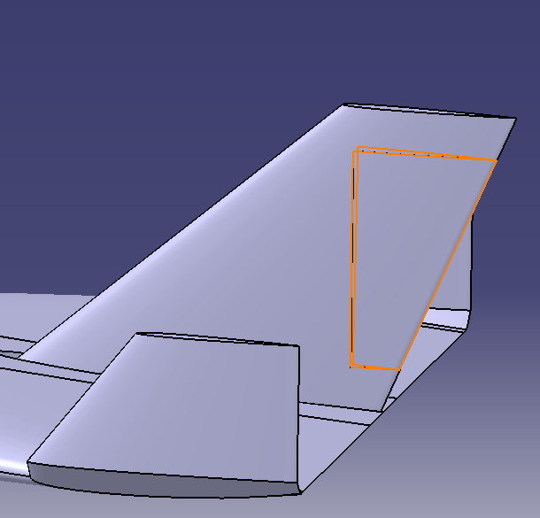
Control Surfaces
Fin/Rudder sizing from historical data
Elevon sizing from historical data

Slide 22

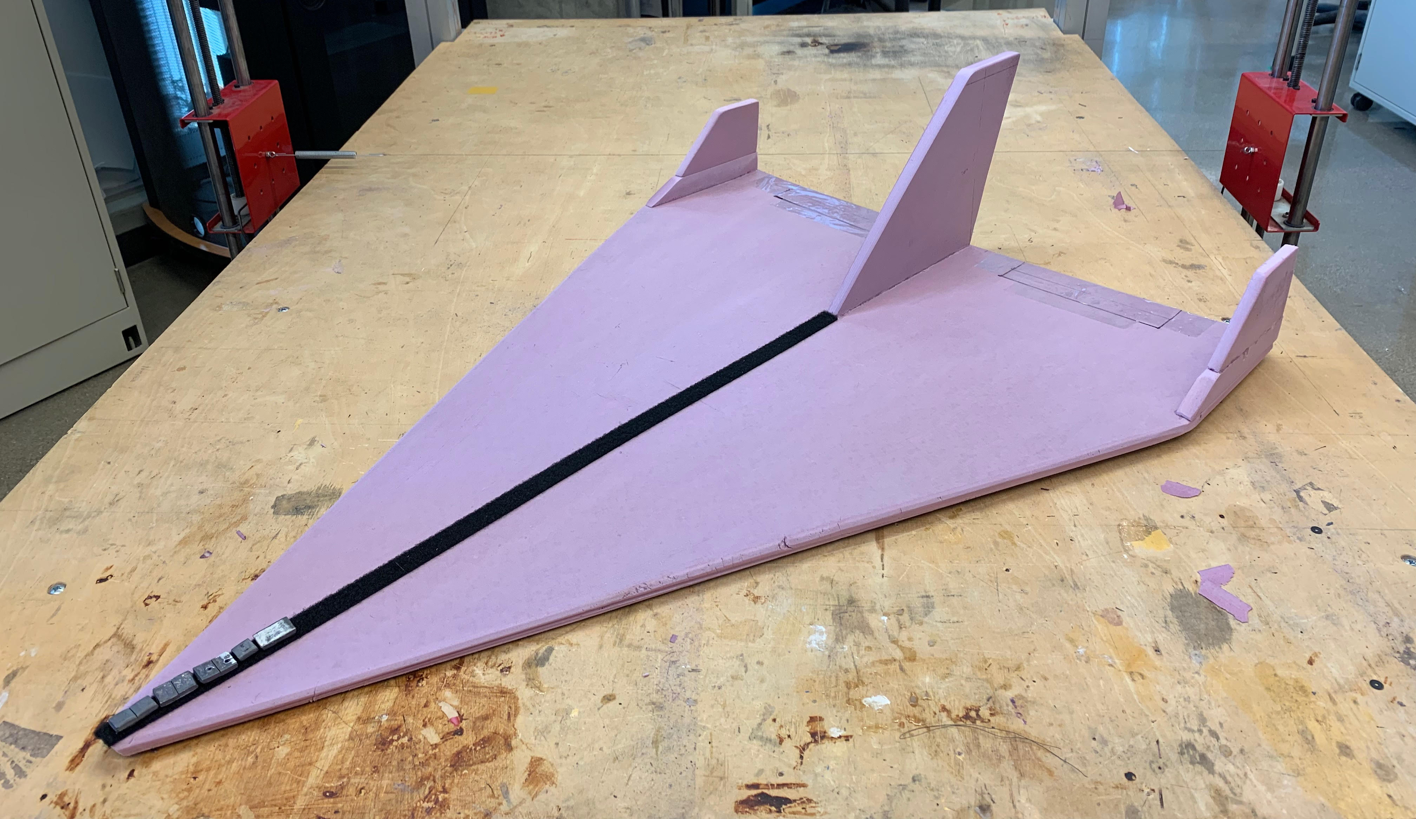
Foam Glider and Center of Gravity
Average Flight Distance (ft) | Average Flight Time (s) | Average Launch Height (ft) | Average Velocity (ft/s) | Average L/D | COG (from front)
27.150 | 1.475 | 6.500 | 19.096 | 4.177 | 0.526 %

Slide 23
Structures/Weights

Slide 24
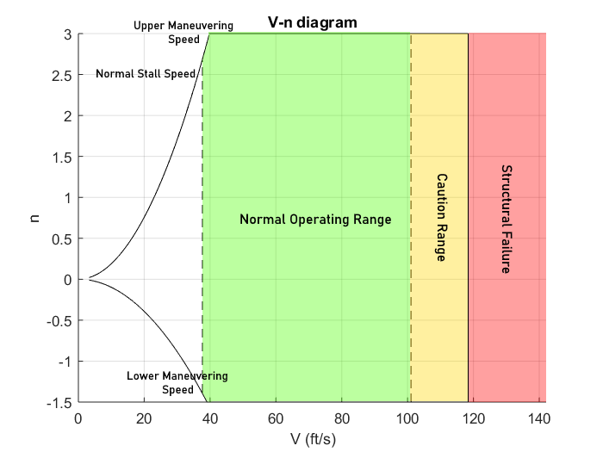

V-n Diagram
Stall speed | 37.694 ft/s
Lower Maneuvering Speed | 39.714 ft/s
Upper Maneuvering Speed | 39.015 ft/s
Structural Bending (7,080 psi) | 101.057 ft/s
Structural Failure (8,840 psi) | 118.397 ft/s

Slide 25
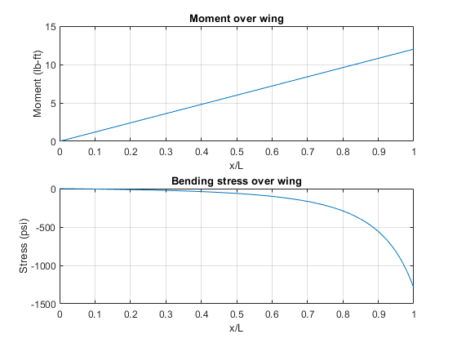
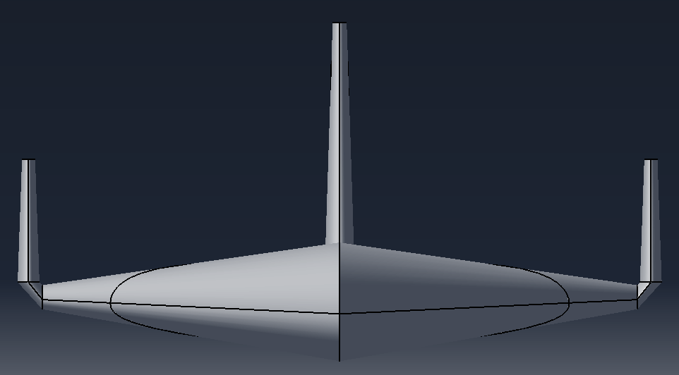
Wing Bending Analysis
60° bank angle
54.504 ft turn radius
Wing box approximation
Safety Factor: 2.960
60°
wing

Slide 26
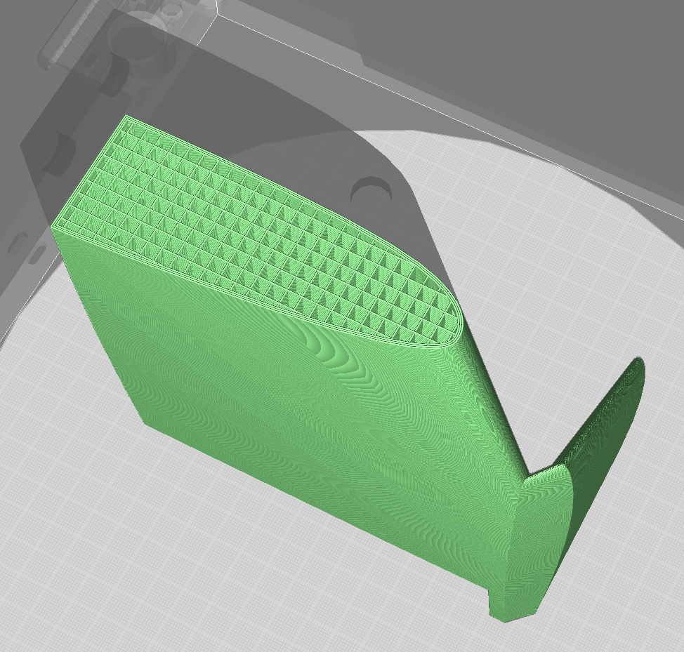

Internal Structure
[1.5 mm] skin thickness
8-12% infill
Walled at connections

Slide 27
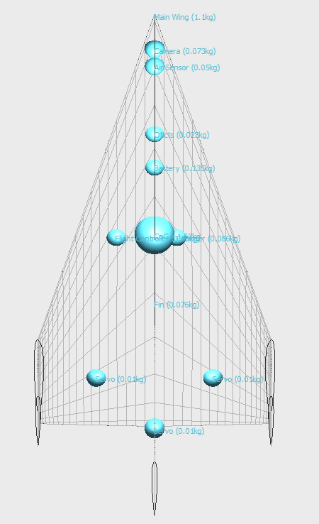
Weights
Flight Controller | 0.110 | lbs
Airspeed Sensor | 0.110 | lbs
Computer | 0.190 | lbs
Optical Sensor | 0.050 | lbs
Camera | 0.160 | lbs
Wiring | 0.500 | lbs
Battery - to power components | 0.099 | lbs
Servo (x3) | 0.066 | lbs
Structural | 2.229 | lbs
Excess | 0.485 | lbs
Total | 3.999 | lbs

Slide 28
Production

Slide 29
CAD

Slide 30
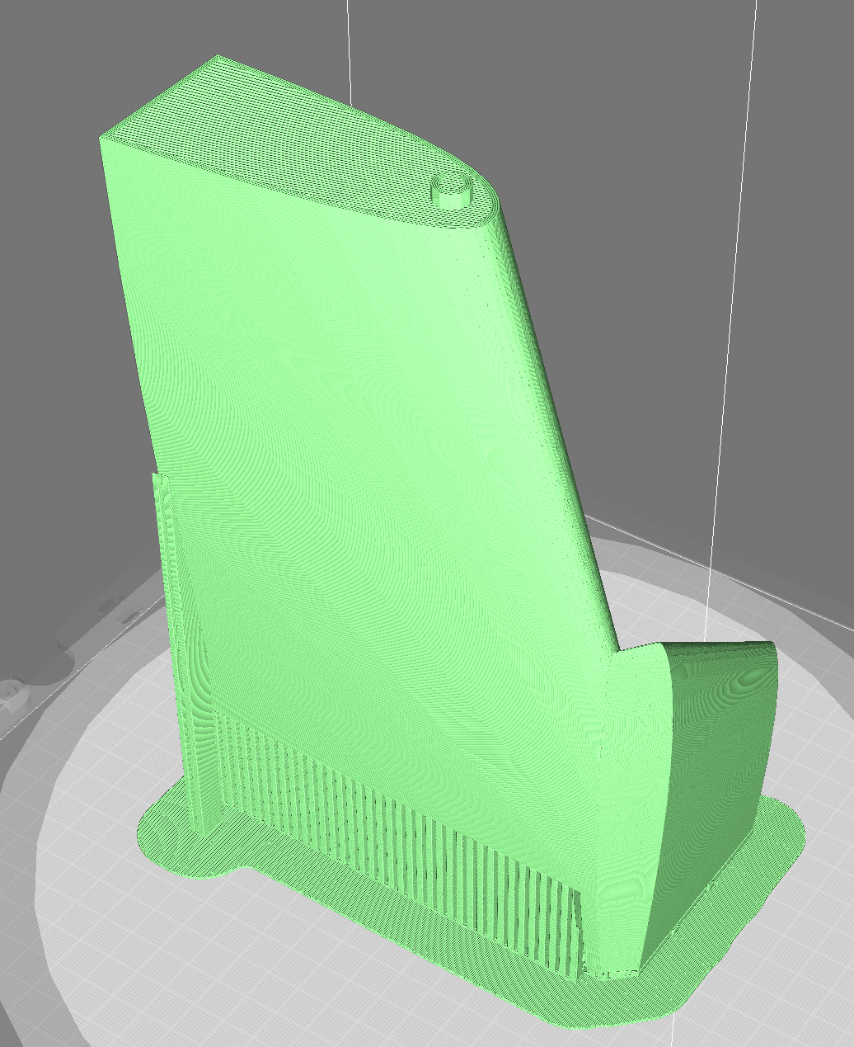
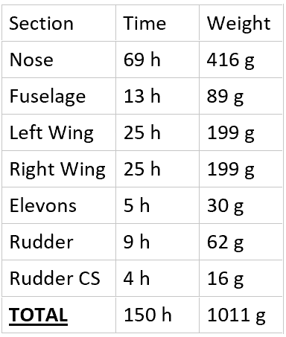
Additive Manufacturing

Slide 31
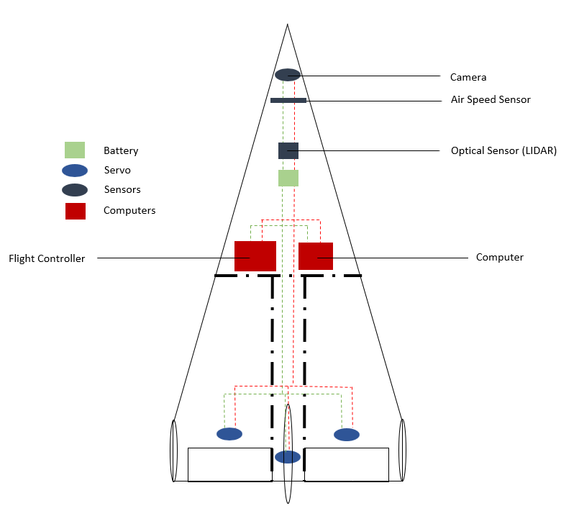
Wiring Schematic

Slide 32
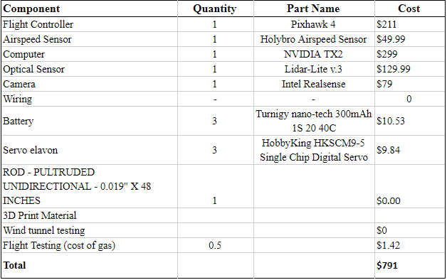
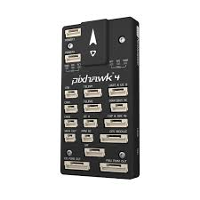
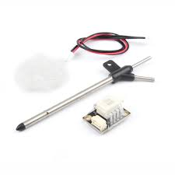

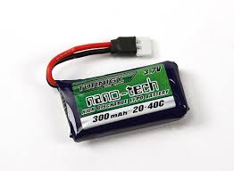
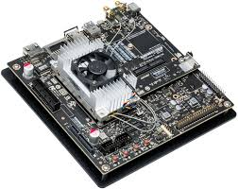
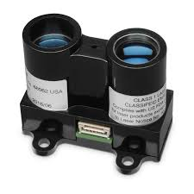
Cost Analysis

Slide 33
Flight Plan

Slide 34
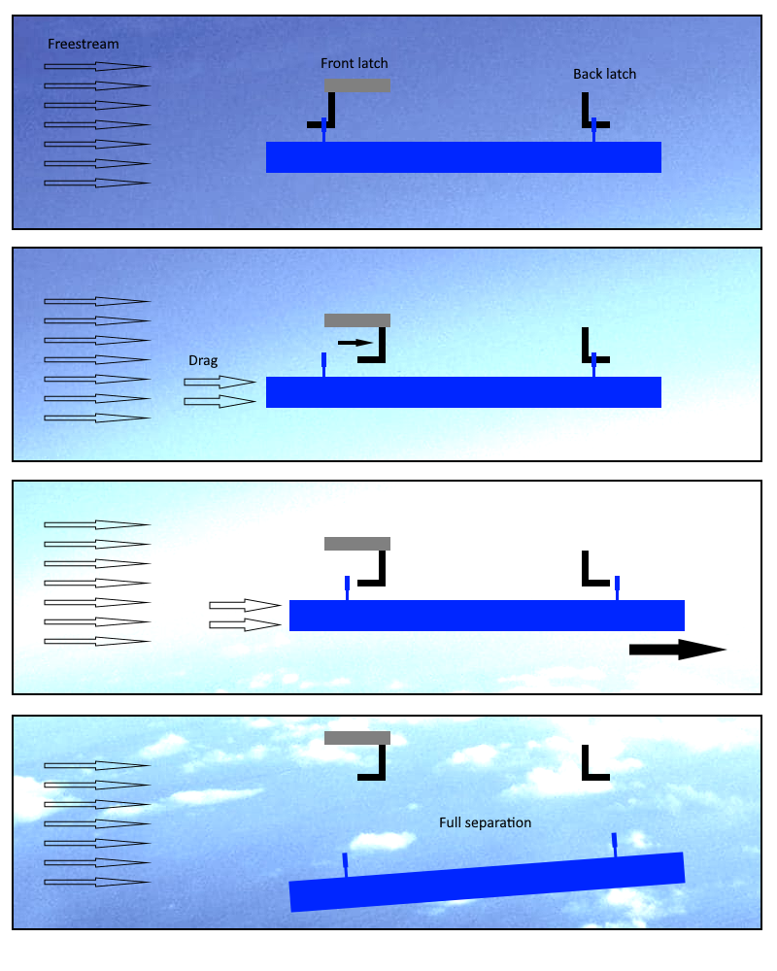
Detachment
Two latches will secure the glide rot the mothership through two fixed points on the glider
The front latch will slide inwards releasing the front of the glider
The force of drag will pull the glider off the back latch, separating it from the mothership

Slide 35
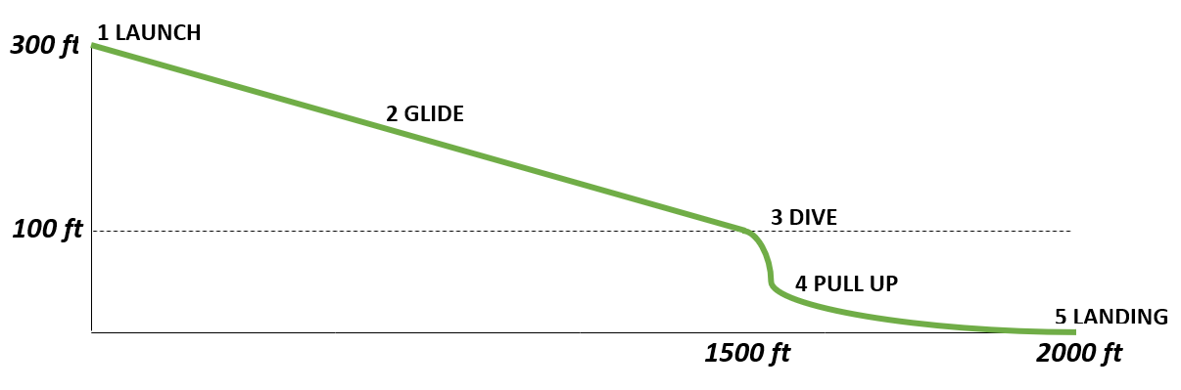
Flight Path and Stages
Launch: Detachment from mothership, begin glide
Glide: Follow flight path given by control team then on-board components locate a ground target
Dive: Steep dive towards ground target
Pull-up: Pull up from dive before impact
Landing : Land gently on ground

Slide 36
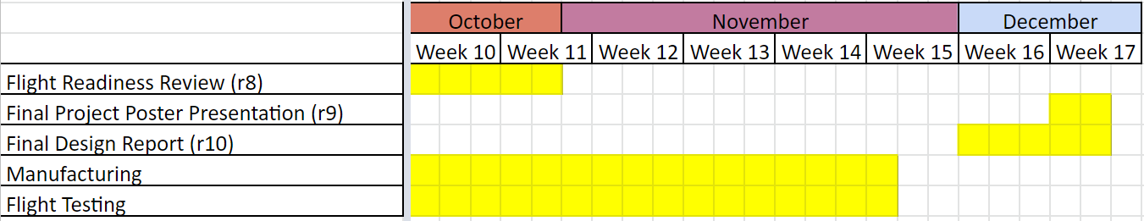
Conclusion
The next steps:
Manufacture/refine glider
Flight testing and further improvement of final glider
Presentation and the moment of truth

Slide 37

Team 7 Mothership Design
By: Ben Dolin, Elias Ghazal, Brad Lock,
Sarah Rasche, Sean Wan, Veronica Yapriadi

Slide 38
Outline
Schedule
Design Decisions
Aerodynamics
Stability
Structures
Landing Gear
Propulsion
Wiring
Cost Analysis
Build and Test
Looking Ahead
Conclusion

Slide 39
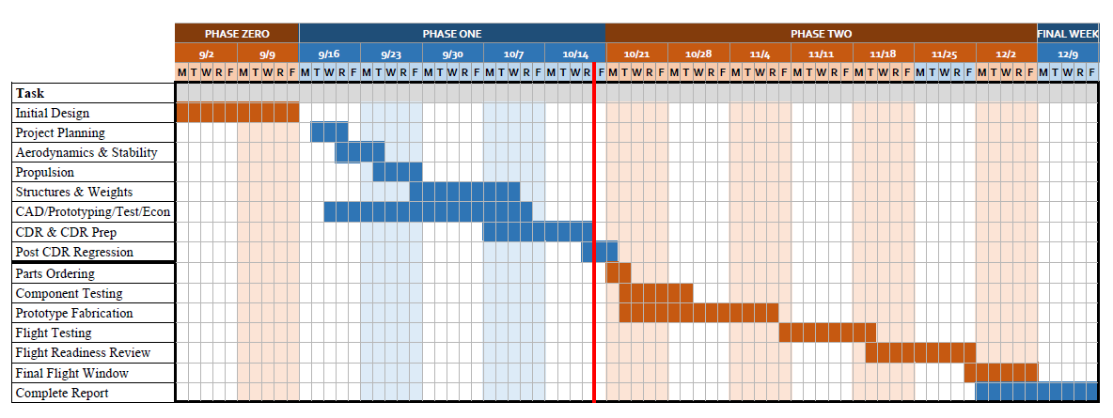
Schedule

Slide 40
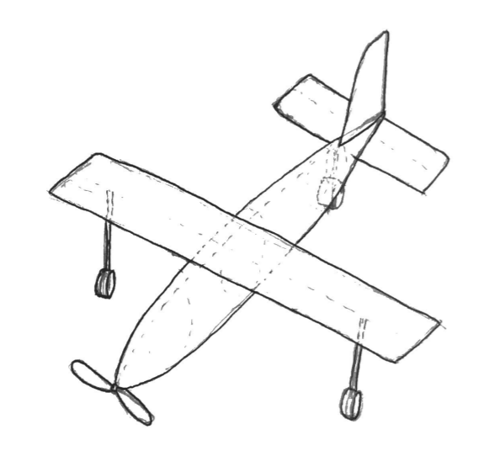
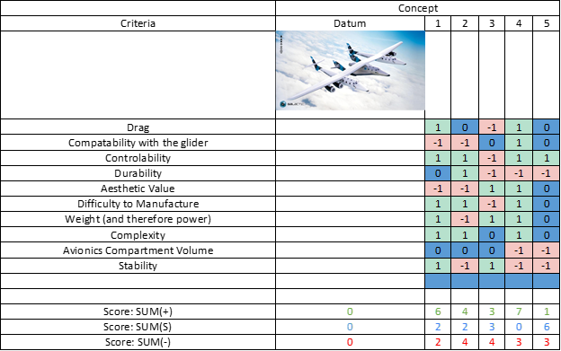
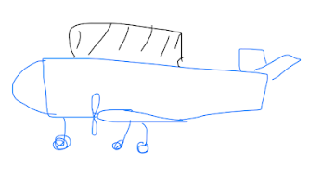
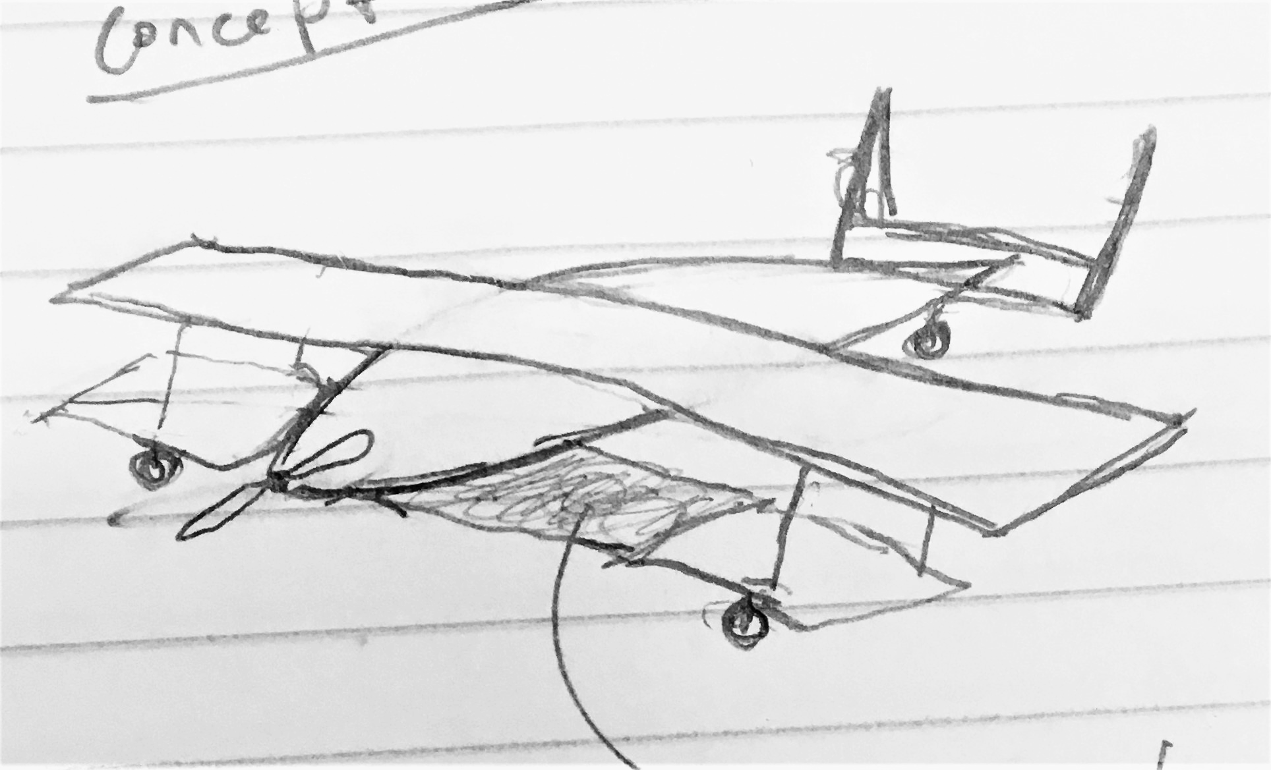
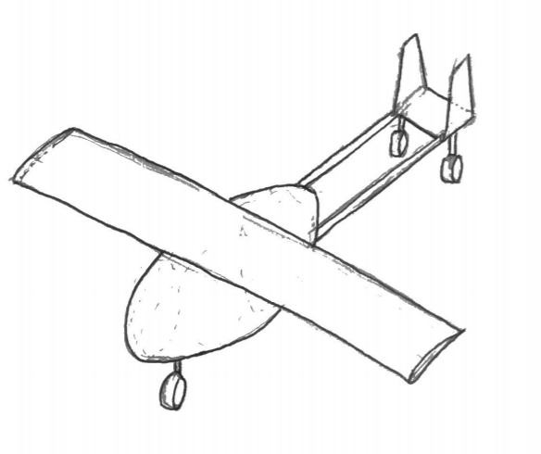
Design Decisions
Concept 1
Concept 2
Concept 3
Concept 4
Notes:
WhiteKnight2

Slide 41

Aerodynamics
Parameter | Value
C_{L,max} | 2.0
C_{L,cruise} | 1.14
𝛼 | 6.5°
C_{d,cruise} | 0.05

Slide 42




Dynamics and controls
Parameter | Value | Stability Requirement
 | -0.54168 | < 0
 | -.00664 | < 0
 | 0.09732 | > 0
Blue Star Represents Trimmed Conditions

Slide 43

Time Response - Longitudinal Short Response

Slide 44

Time Response - Lateral Short Response

Slide 45



Control System
Radio Control System
AR8000 8-Channel DSMX Receiver
Visual attitude feedback
Air Data from glider pitot tube before drop

Slide 46

Structures - Wing Characteristics
Maximum Loads
Maximum Bending Load | 331.01 N
Maximum Torsional Load | 1.95 N
𝜙_{max} | 0.11°
Maximum Wing Root Bending Moment | 66 Nm
Maximum Wing Tip Vertical Deflections | 38.9 cm
Notes:
Wing box for analysis assumed to be rectangular cross section to simplify analysis and estimate loads. PLA yield strength 35.9 MPa
https://www.sd3d.com/wp-content/uploads/2017/06/MaterialTDS-PLA_01.pdf
With a bank angle of 85 degrees the max stress experienced on the wing would be 7MPa, well within limits.

Slide 47

Structures - V-n Diagram
V_{speeds} | (m/s) | (kts)
V_{A} | 32.2 | 62.6
V_{C} | 32.4 | 63
V_{S1} | 15 | 29.2
V_{D} | 45.4 | 88.2

Slide 48

Landing gear
Configuration | Tail Dragger
Height | 12 cm
Width | 5 cm
Material | Aluminum 5052
Bending radius | 0.5 cm
Tail down angle | 11 degrees

Slide 49


Mothership Performance with Glider
5 minutes flight time with glider:
Required Battery Weight: 4.206N
Voltage: 18.93 VDC
Current: 46.6 A

Slide 50


Mothership Performance without Glider
14 minutes powered flight time with glider:
Required Battery Weight: 7.477 N
Voltage: 18.07 VDC
Current: 31.5 A
OVERALL MISSION:
Max Voltage < 22.2 VDC
Max Current < 70 A
Max Weight ≈ 11.65 N

Slide 51



Propulsion - Propeller
Hub Thickness | 0.48 in
Airfoil section | NACA 4412
Twist distribution | Constant
Chord distribution | Linear
Requirements:
Required thrust = 14.43 N
Selected: APC 12x6 Propeller
Notes:
Max. rotation rate = 15,800 rpm
Required thrust at 21 m/s
J = advance ratio

Slide 52

Propulsion - Electric Motor
Requirements:
Power = 855 W
Rotation rate = 10,000 rpm
Selected: SunnySky X3520 Brushless Motor
Overview:
Max. rotation rate = 11,544 rpm
Can support up to 6s LiPo cell battery and ESC between 80 A to 100 A
Max. Continuous Power | 1750 W
Motor efficiency | 8.04 g/W
Motor Kv | 520
Rated voltage | 22.2 V
Rated number of cells | 4-6s
Weight | 207 g
Manufacturer | SunnySky USA
Notes:
Motor Kv = 520 → number of rpm achievable with voltage (rpm/voltage)
Rated voltage = 22.2 V
Rated number of cells = 4-6s
Rated ESC between 80 A to 100 A

Slide 53

Propulsion - Battery
Requirements:
Charge = 9000 mAh
Voltage = 22.2 V
Continuous current = 50 A
Selected: Multistar High Capacity 10000mAh 6S 10C Multi-Rotor LiPo Pack XT90
Number of Cells | 6S
Amp Hours | 10000 mAh
Volts | 22.2
Number of Batteries | 1
Weight | 1.189 kg
Height | 65 mm
Length | 156 mm
Width | 53 mm
Notes:
To meet flight duration and power requirements of our mission we chose this battery
Amp hours = 10,000 mAh
Voltage = 22.2 V

Slide 54

Propulsion - ESC
Selected: 80-Amp Pro Switch-Mode BEC
Brushless ESC, EC5 (V2)
Specifications:
Can take a 3-6 cell lithium polymer (LiPo) battery and draws up to 22.2V of voltage
Can drive up to 7 analog or 6 digital standard-size servos
Has programmable braking setup
Amperage | 60 & up
BEC Continuous Current | 5A
BEC voltage | 5.5V Switch-mode
Input Connector Types | EC5, 10AWG leads
Output Connector | 4mm Gold Bullet, 12AWG leads
Notes:
We chose this ESC bcs it is compatible with our electric motor specification: 80 A - 100 A
BEC = battery eliminator circuit
6 cell lithium polymer battery
Supplying Continuous current = 5 A
Supplying Voltage = 5.5 V
Can drive up to 6 digital standard-size servos
Has programmable braking setup

Slide 55

Wiring Diagram

Slide 56

Cost Analysis of Mothership
Total Material Cost: $1,158.79

Slide 57
Build Plan
Task | Details | Deadline
CDR | Design freeze, presentation in class | 10/17/2019
Parts Ordering | Order parts on the Parts Acquisition List that are not available in lab | 10/22/2019
Component Testing | Start testing components that are available in the lab after CDR and test the ordered parts as soon as they arrived | 10/29/2019
Prototype Fabrication | Print and clean up all 3D printed parts and test the connections of each | 11/07/2019
Flight Readiness Review | Schedule the flight readiness review | 11/16/2019
Flight Testing | Fly the aircraft | 11/17/2019

Slide 58
Test Plan
Test Number | Deadline | Location | Objective
4510701 | 10/31/2019 | Build Lab - ARMS 2098 | System Ground Check
4510702 | 11/07/2019 | Build Lab - ARMS 2098 | Propulsion Check
4510703 | 11/14/2019 | Build Lab - ARMS 2098 | Mission Mechanism Check
4510704 | 11/16/2019 | McAllister Field | First Flight (straight line and turning flight)
4510705 | 11/25/2019 | McAllister Field | Mission Profile Flight (without glider)
4510706 | 11/25/2019 | McAllister Field | Mission Practice (with glider)

Slide 59
Remaining problems and solution plans
Confirm servo sizing for the flaperons
Update CAD to slight dimension changes

Slide 60
Conclusion
Moving forward:
General Layout is Final
Ready to start building after slight CAD modifications

Slide 61
Appendix

Slide 62


Slide 63



Slide 64



Slide 65
https://www.sd3d.com/wp-content/uploads/2017/06/MaterialTDS-PLA_01.pdf
Glider inspiration:
https://www.boeing.com/history/products/x-20-dyna-soar.page
Glider inspiration:
https://www.space.com/41042-boeing-hypersonic-passenger-plane-concept.html
Glider inspiration:
http://www.aerospaceweb.org/design/waverider/design.shtml
Glider airfoil source:
http://airfoiltools.com/airfoil/details?airfoil=s4094-il

